Slide 1

i-Learn Application
An e-Learning Application that can be customized to meet the account level Training needs
By – DEEPAK TIWARI [ U43779 ]

Slide 2


Objective of iLearn
To set up a Learning Management System (LMS) which uses light open source Technologies to cater to the Account level specific Training needs.
A system that can be governed and managed by Account Technical Lead/Architect to educate the associates on required Technology stack.
To have a LMS that is purely open source and unlike Kubera is not required to use licensed SCORM Engines or SCORM Compliant courses. That saves a lot of cost and thus the project is entirely suitable for meeting Account Level Entry, Induction and Role based Competency needs.
The system relies on Open source course authoring tools and uses simple and fast UI on bare essential hardware to run upon.
The tool uses a Technology Stack that is fully Open source, uses minimal hardware and can support good number of Concurrent users within SLA Response time.
To provide a Dashboard to User at Account level , where the Course Admin can drop in important Account level Newsletters , Information , Resources , Courses ,Quizzes ,Statistics and also a Chat Engine. The system should be horizontally scalable to allow for new modules to be integrated.
The system should also be able to define the Exit Criteria for Associates joining the Project.
The system should capture the Learning & Competency History of Associates and should be able to provide him/her feedback continually to improve upon.
The system should also be able to capture Associates Projects/Designs and Awards.

Slide 3


Salient Features of iLearn
Dashboard for User where he can see his statistics , performance , newsletters , courses , quizzes , chat windows and what is happening at Account level. This remains the most interesting & interactive feature of LMS.
Open Source LMS which does not uses any licensed SCORM Engine and Courses like Kubera and can be customized as per Account level needs.
Easy authored HTML5 Courses which can include Pictures , Animation , Audio and Video.
Fully Secured and Authenticated Quizzes with proper scoring and track record.
Admin Page from where the Course Admin can Upload Courses ,Quizzes and Global Information/Newsletters and Everyday Artefact .
The portal is self adjusting to various view port devices like Desktops,Tabs,Mobiles using Scaffolding Design pattern.
REST Architecture based Technology Stack which is highly efficient, fast ,uses minimal hardware and is extensible.
Is only required to use light weight Open Source database for Quizzes.
A Mail API through which the Associates can drop in their queries regarding any Training need to the Course Admin or Account level Architect.
Rich UI with efficient navigation. Good performance . Scalable and Extensible Architecture. UI is Theme based and is user selectable.

Slide 4
Value Add to Kubera
Open Source LMS.
Does not uses any complex SCORM level Integration and SCORM Courses.
Easy HTML5 Interactive courses that are purely PPT bases and can include all
Animations, Videos and Audios.
Can be easily customized by any account to meet their Entry , Induction and
Exit level criteria.
Includes provision to convert PPT based courses to HTML 5 based and uses an
in built upload engine for Course Admin to upload the courses to portal.
Can be customized in any way to setup Courses and Quizzes.
The LMS is extremely light weight <20 MB and uses all Open source
technologies with minimal deployment hardware.
Quizzes are purely JSON Schema based and requires JSON files that need to
be uploaded to Quiz engine that uses Session and Authentication algorithms
with proper encryption.
Efficient Account Level Induction Need and Competency tracking for an
Associate with clear visibility to required Stakeholders who can use the same
for Evaluation.

Slide 5
Progress as on Date
Dashboard Available with portability on Desktop, Tablets and Mobiles.
Course , Quiz and Artefact Upload Module Available
PPT to HTML 5 Authoring tool Available
Admin and Student Login enabled
Session and Authentication Management Module for Quiz is available
Launch of Courses available
Launch of Quizzes available
Customization of UI is enabled through JSON.
Quiz creation via JSON Schema template is available
Feature to add images and MCQ’s to Quizzes is available.
Feature to add Video is available
Chat Engine HTML Template has been coded.
Integration of Graphs is also available for various score metrics.
Build and Deployment Module is properly configured for UI.
Application will run on different port and static assets will be delivered from another port via two instances of http and express server for optimal use.
This has already been configured.

Slide 6
Technology Stack Used
AngularJS 1.4 – as client MVVM Framework
Bootstrap - for CSS
Jquery – for UI
Underscore.js – for UI
RequireJS - as AMD Module
Jasmine – as Unit Test runner
Grunt - Task runner
NodeJS - Server side JS
NPM – JS package manager and dependency mapping
Bower – Dependency resolver
ExpressJS –server for static assets
http-server – npm package for LMS Application
HTML 5 – UI BUILDING
Git - for Code Versioning and Repository Sync ups with Github.

Slide 7
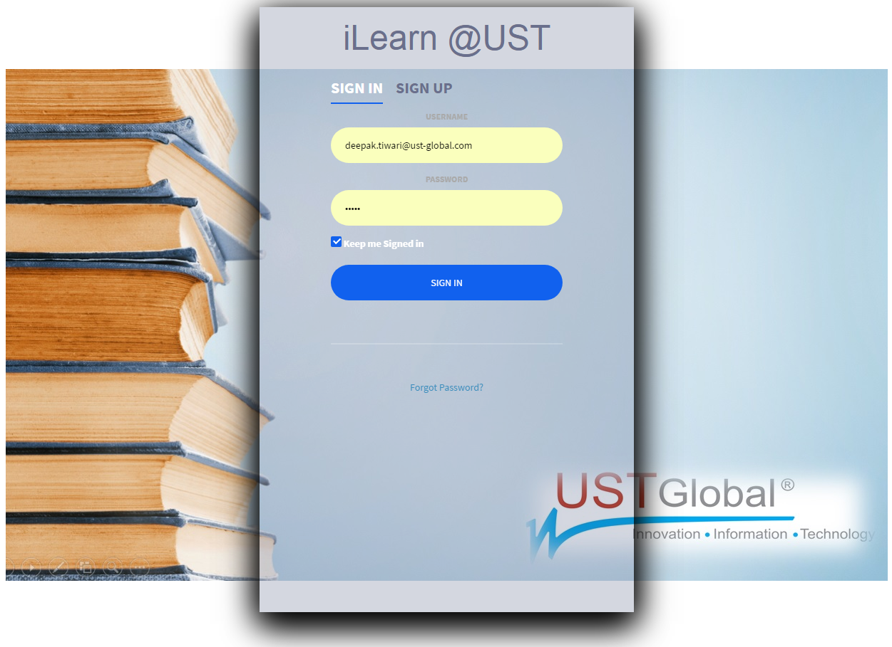
Screenshots

Slide 8
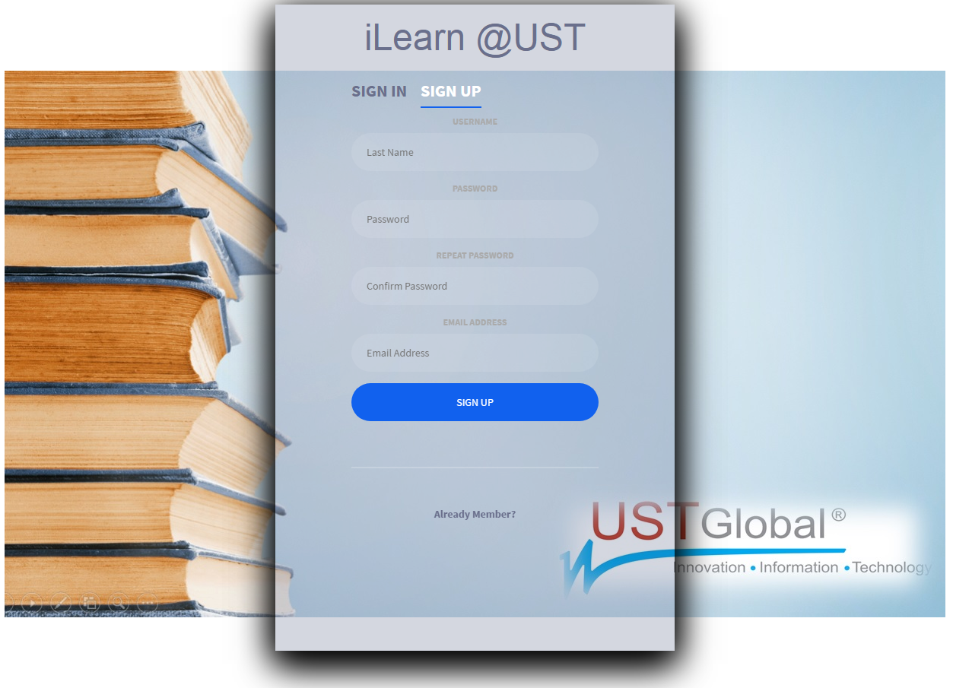
Screenshots

Slide 9
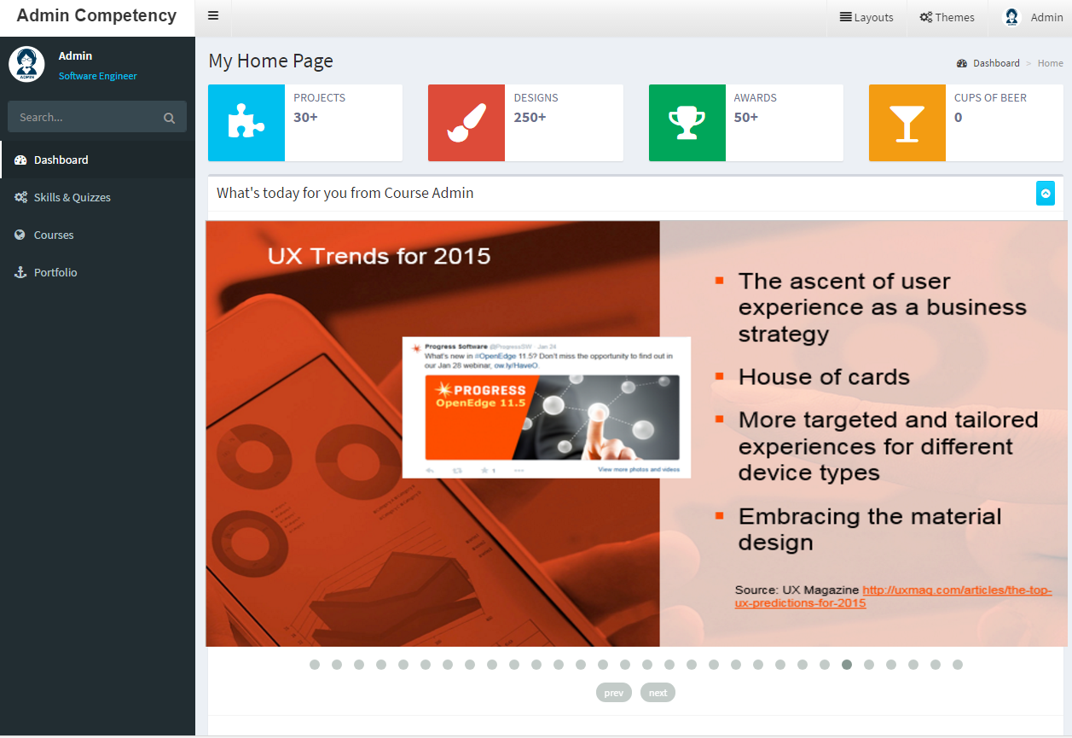
Screenshots

Slide 10
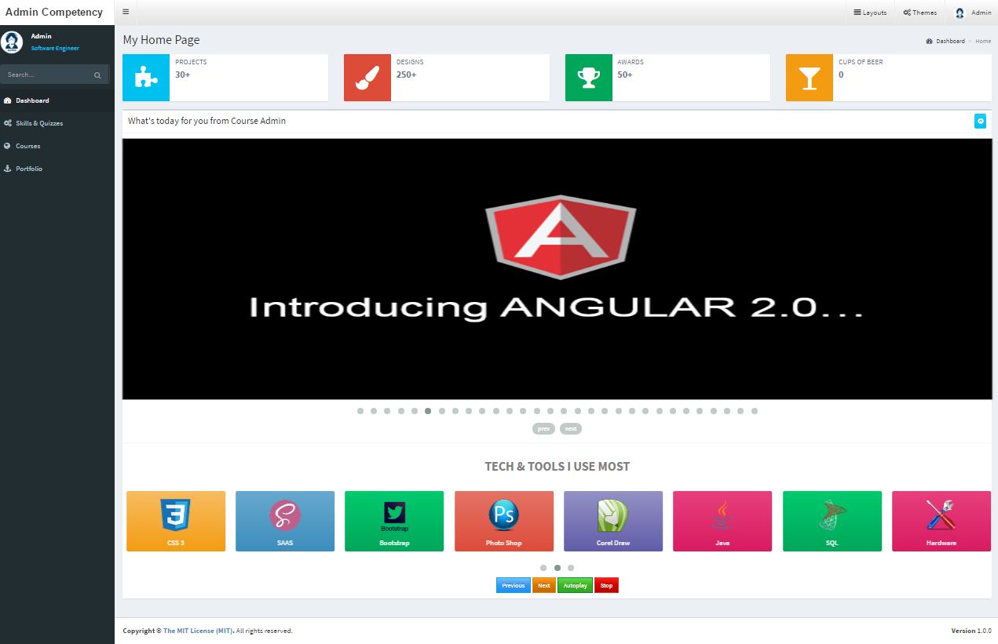
Screenshots

Slide 11
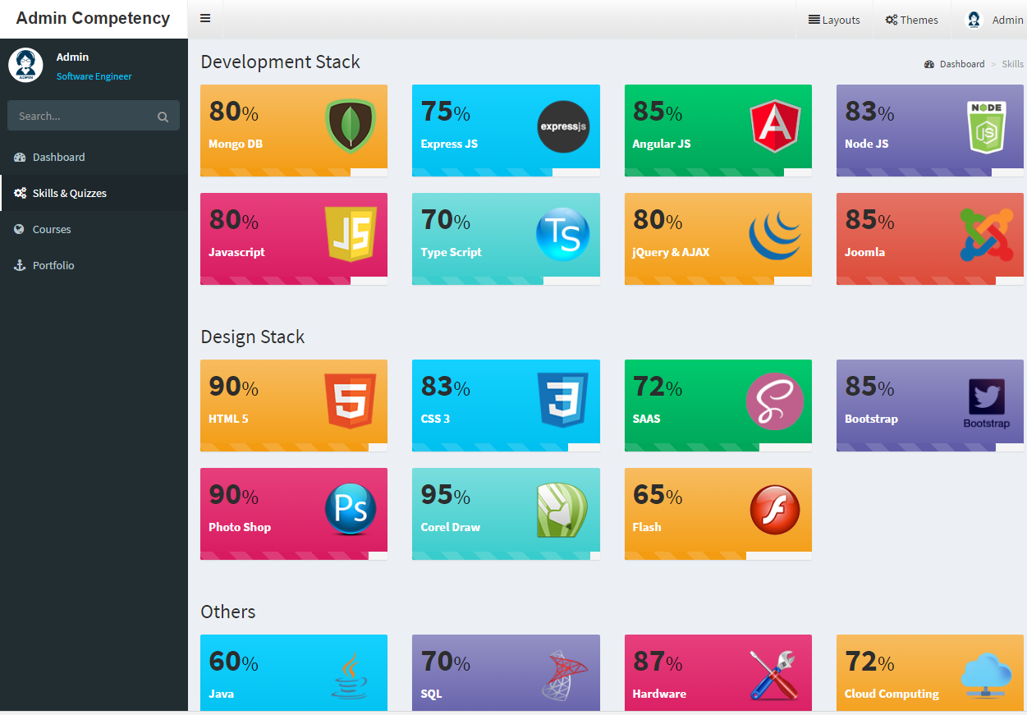
Screenshots

Slide 12
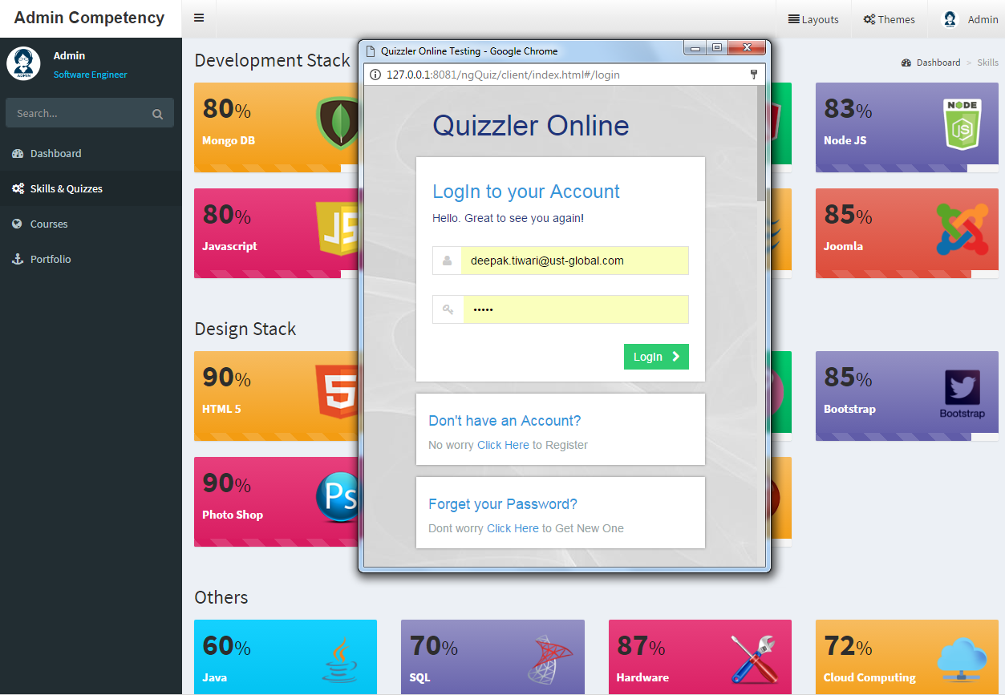
Screenshots

Slide 13
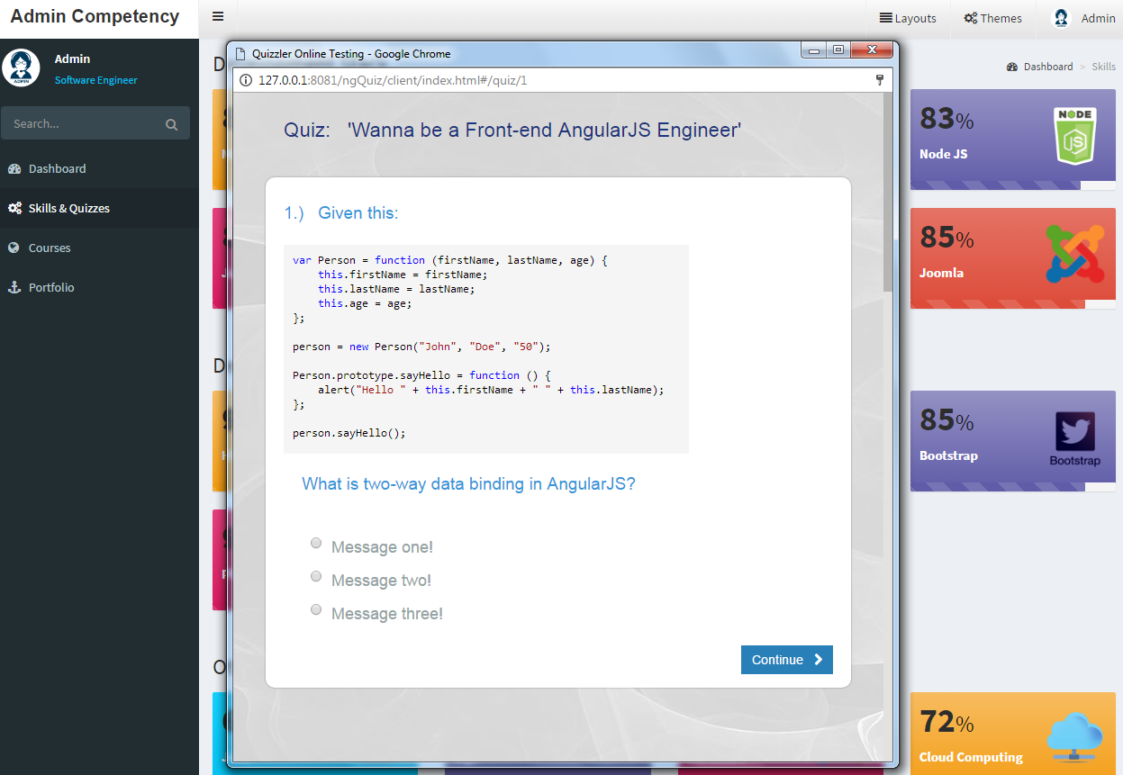
Screenshots

Slide 14
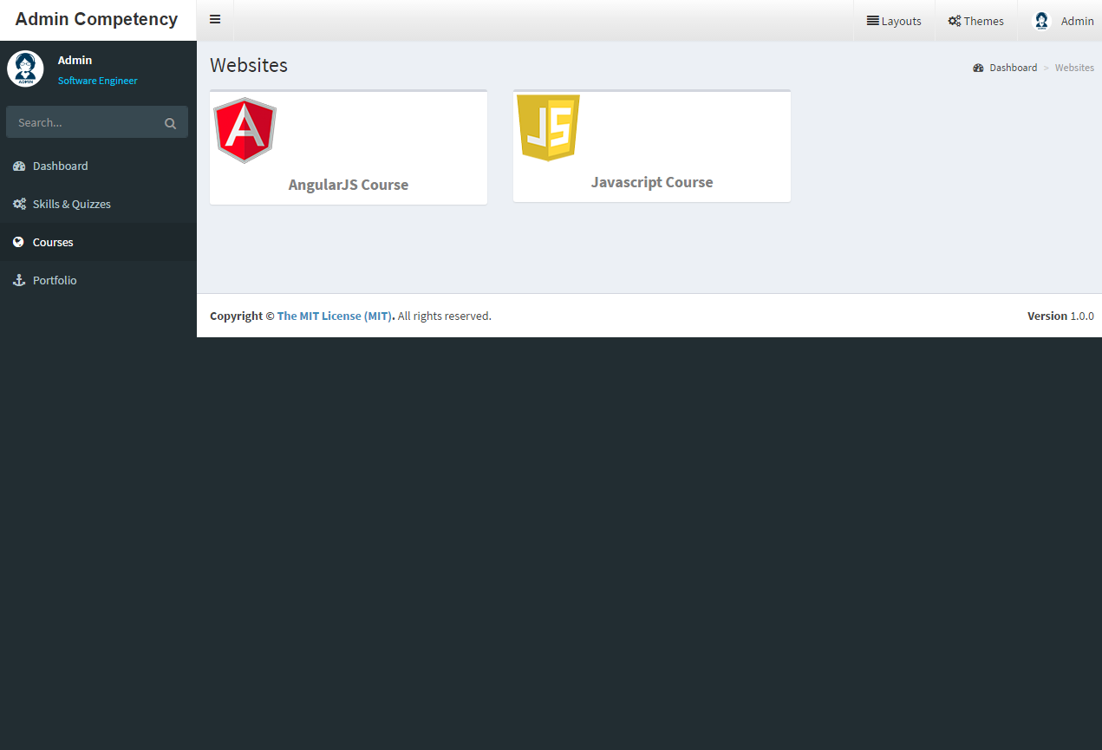
Screenshots

Slide 15
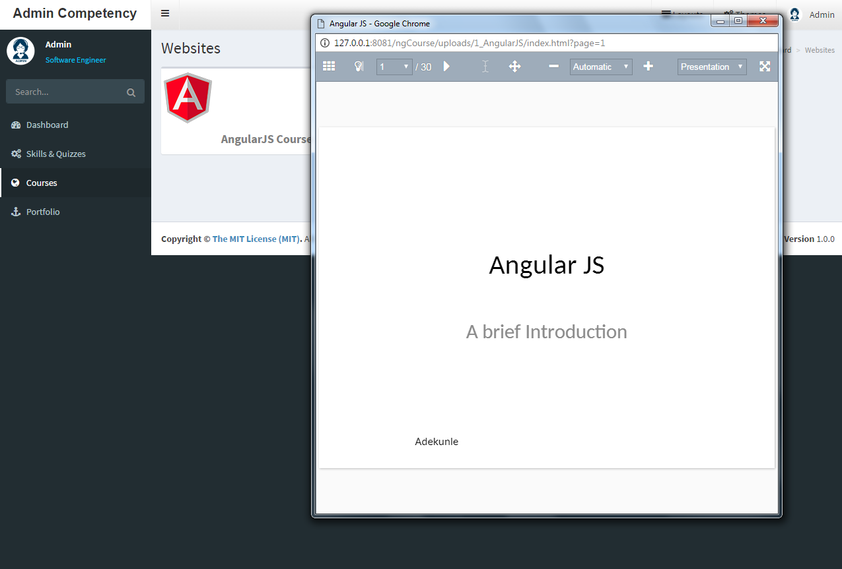
Screenshots

Slide 16
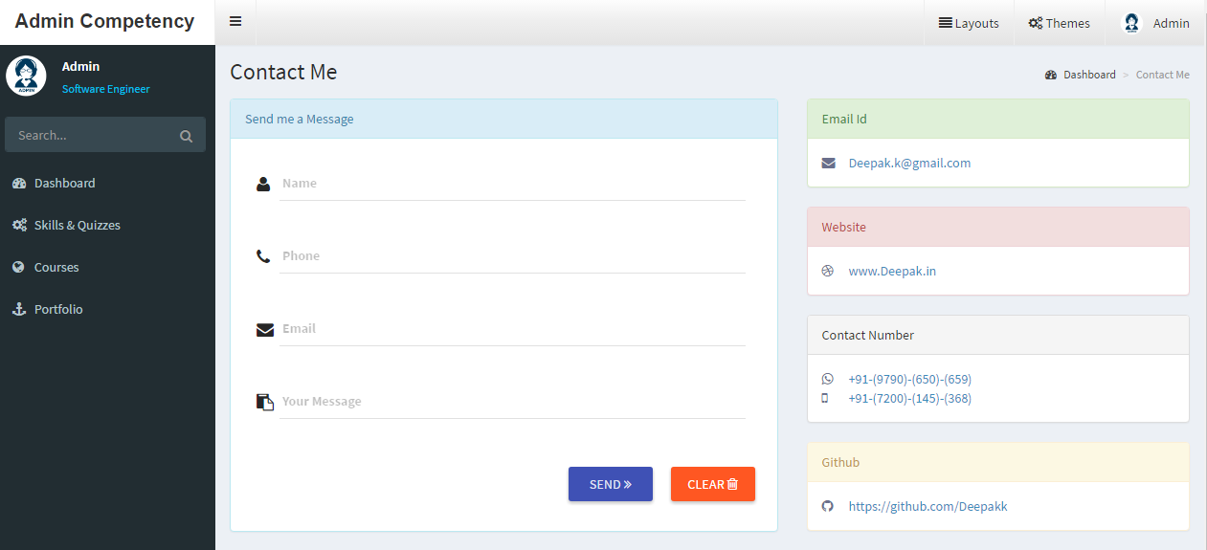
Screenshots

Slide 17
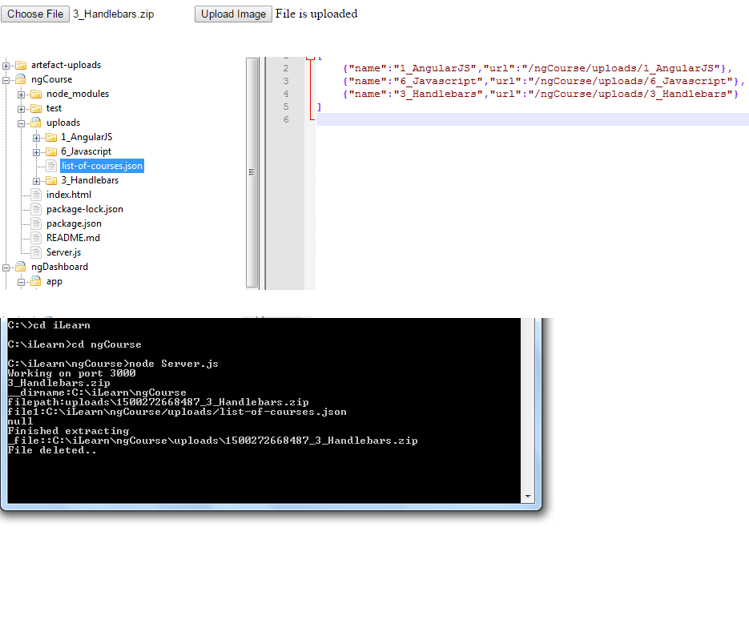
Screenshots

Slide 18
Thank You

